Slide 1
Machine Learning Overview

Slide 2
Key questions
What can you do with machine learning? (and what can’t you do?)
Where does ML fit in a data-to-decision workflow?

Slide 3
A short history of the world…
The earth cooled
(… time passes…)
Humans <arrived*> and made decisions
Language and Math/Logic is created and people write rules for making decisions
Computers invented: able to make faster decisions
Humans write fixed programs to make decisions using (probabilistic) distilled judgements about relationships in the data [Expert systems]
Humans decided that the computer would be better at learning statistical relationships between attributes of the data [Machine Learning]
*Insert scientific and/or religious word of your choosing here

Slide 4
Thoughts on Machine Learning? (discussion)
Is Machine Learning is the same as Artificial Intelligence?
Is Machine Learning a Black Box?
Can we understand/explain what it has learned?
Is Deep Learning better than Classical Machine Learning?
If your data is complex (imagery, video, text, audio) then do you need Deep Learning?
Are there differences between Statistical Machine Learning and Reinforcement Learning?

Slide 5
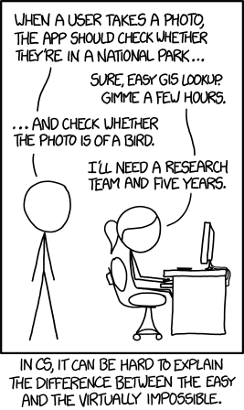
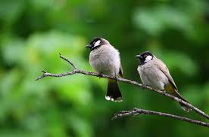

What can you do with Machine Learning?
Infer how data elements are related
Does ice cream consumption depend on outdoor temperature?
Make predictions about a target variable within a dataset
How much ice cream will be consumed this summer in Ohio?
Determine the category something belongs to
Bird vs non-bird
https://www.pexels.com/search/birds/
https://en.wikipedia.org/wiki/Strelitzia
xkcd #1425 (View original here)

Slide 6
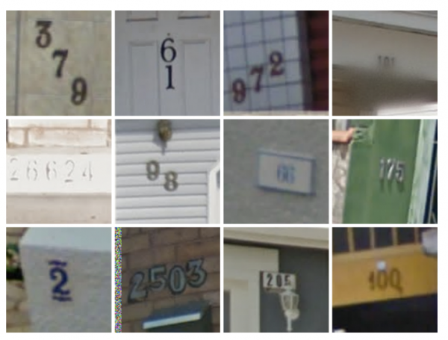
What can you do with Machine Learning(2) ?
Optical Character/Number recognition
Translate Text between languages
Audio<->Text
Find Components of an image
Describe the contents of an image
Pick the best <restaurant; movie; product; …> for me
https://www.technologyreview.com/s/523326/how-google-cracked-house-number-identification-in-street-view/

Slide 7
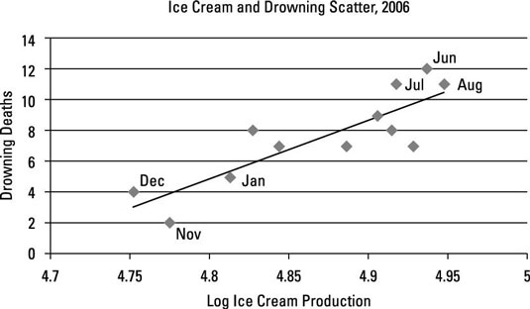
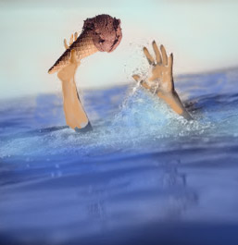
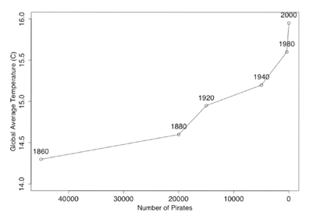
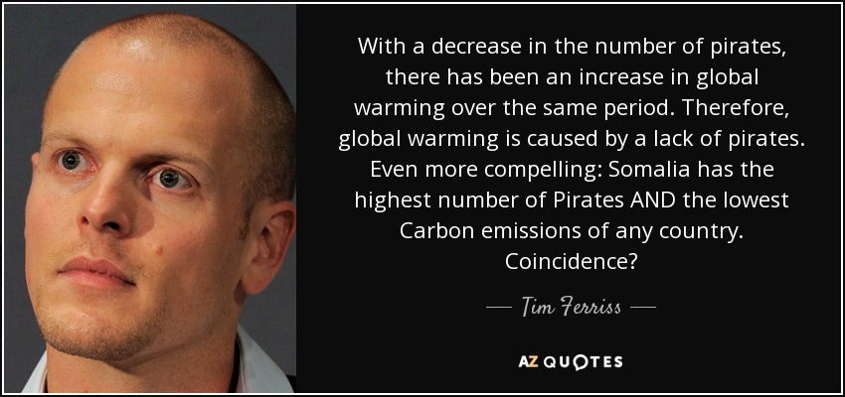
What can’t you do with ML?
Determine causality
Production of ice cream is correlated with drowning. Which way is the causality?
Determine whether data is Evidence or Coincidence
http://www.dummies.com/education/economics/ econometrics/the-role-of-casuality-in-econometrics/
http://sourcesandmethods.blogspot.com/2011/03/passport-ownership-cures-diabetes.html

Slide 8
What can’t you do with just ML (2)
Find the fastest route to an address on a map (use a cost-based pathfinding algorithm)
Learn to Play Chess, Checkers, Go (efficiently) (use a heuristic deep search algorithm)
Determine geocoordinates from only a photo (this only works for some common locations…)
Drive a vehicle autonomously (this requires much more than ML)

